Slide 1
Disposing of Classes
Trainer – Danilo Borozan
Co-Trainer – Ilija Mitev

Slide 2
LOOKING BACK AT...
How can we write on file system?
What happens when we create a file with File.Create and try writing something in it?
What are StreamReader and StreamWriter used for?

Slide 3
AGENDA
A C# class instance lifecycle
What is disposing
Using disposable classes
Building a custom disposable class
What are optional and nullable values

Slide 4
STORING IN MEMORY
Everything that we code is stored somewhere in the memory
In order to be operated more efficiently, stuff can be stored in:
Stack - A memory where value types and references to objects are stored
Heap - A memory where objects are stored
.NET Framework manages the heap automatically

Slide 5
C# CLASS INSTANCE LIFECYCLE
When we create an instance of a class with the new keyword we get only a reference to that object
When our code finishes the reference is removed from the stack, but the object stays in the heap
At some point .NET Framework system for cleaning up will see that there is no reference to that object and will remove it from the heap as well

Slide 6
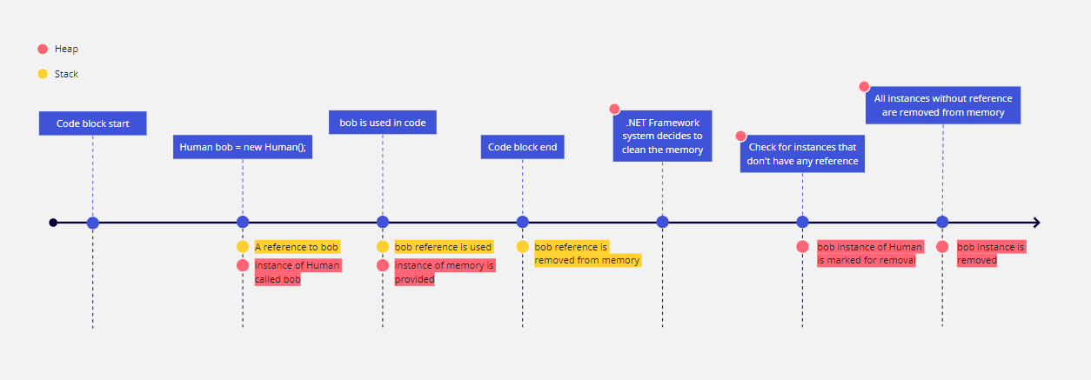

Slide 7
WHAT IS DISPOSING?
Sometimes there are objects that need to be removed from memory manually
These usually depend on something like a connection to some network, database or a file for example
This is called disposing of an instance
There are already built in features in the .NET framework for disposing manually
Disposable classes can be used in a using block so they can be disposed automatically when we are done

Slide 8
BASICS OF GARBAGE COLLECTOR
The system in the .NET Framework that is tasked with cleaning up the heap is called a Garbage Collector
The garbage collector runs when some parameters are met, such as our application using too much memory or the operating system needing more
It searches which objects do not have a reference and cleans them out of the memory
Uses generations to organize objects that are used frequently and objects that are not

Slide 9
NULLABLE TYPES
Types can have a null as a value as long as the type is nullable
Nullable type is a type that can hold the initial range of values plus the value null
Nullable values are marked by a ? after the type
Types can have a null as a value as long as the type is nullable

Slide 10
NAMED AND OPTIONAL ARGUMENTS
Arguments can be named when they are given to a method
With named arguments we can ignore the order of the parameter as long as all the arguments are named
We can name some of the arguments, but then we need to follow the order in which they are given
We can also set optional arguments by giving a default value next to the parameter

Slide 11
QUESTIONS?
You can find us at
trainer@mail.com
assistant@mail.com
You can find the code at:
Repository with the code Link

